Slide 1
Assertions

Slide 2
Outline
This is the first in a sequence of six topics on
C assertions
Code development strategies
Testing
Commenting your code
Using print statements for debugging
Using tracing for debugging

Slide 3
Outline
In this tutorial, we will:
Describe the assert “function”
Consider its uses
See how to turn assertions off

Slide 4
C-style assertions
Up to this point, we have only executed functions and dealt with all possible arguments
For example, the factorial is not defined for negative integers
We, however, returned zero
Also, we have arbitrarily executed the alternative body in a conditional statement
Can we check to make sure that the conditions are as expected?

Slide 5
C-style assertions
An assertion is a “function” that takes a Boolean-valued condition
If the condition is true, the program continues executing
If the condition is false, the program terminates with an error
For example:
int factorial( int n ) {
assert( n >= 0 );
int result{1};
for ( int k{1}; k <= n; ++k ) {
result *= k;
}
return result;
}
It is actually a macro, which is
beyond the scope of this course

Slide 6
C-style assertions
To use the assert function, you must include the C assert library:
#include <cassert>
Suppose we have the following program:
#include <iostream>
#include <cassert>
// Function declarations
int main();
int factorial( int n );
// Function definitions
int main() {
std::cout << factorial( 10 ) << std::endl;
std::cout << factorial( 0 ) << std::endl;
std::cout << factorial( -2 ) << std::endl;
return 0;
}
Output:
3628800
1
a.out: example.cpp:18:
int factorial(int):
Assertion `n >= 0' failed.

Slide 7
C-style assertions
Output:
0! = 1
1! = 1
2! = 2
3! = 6
4! = 24
5! = 120
6! = 720
7! = 5040
8! = 40320
9! = 362880
10! = 3628800
11! = 39916800
12! = 479001600
13! = 1932053504
14! = 1278945280
15! = 2004310016
16! = 2004189184
17! = -288522240
Consider this program:
#include <iostream>
#include <cassert>
// Function declarations
int main();
int factorial( int n );
// Function definitions
int main() {
for ( int k{0}; k <= 17; ++k ) {
std::cout << k << "! = "
<< factorial( k ) << std::endl;
}
return 0;
}

Slide 8
C-style assertions
Thus, a better implementation of the factorial function is:
int factorial( int n ) {
assert( (n >= 0) && (n <= 12) );
int result{1};
for ( int k{1}; k <= n; ++k ) {
result *= k;
}
return result;
}

Slide 9
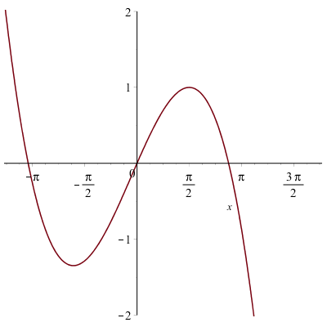
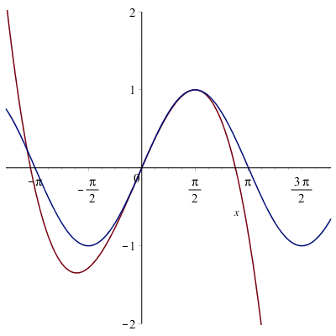
Example
Previously, we introduced a spline
When plotted next to the sine function,
it’s a good approximation if

Slide 10
Example
#define _USE_MATH_DEFINES
#include <cmath>
#include <cassert>
#include <iostream>
// Function declarations
int main();
double my_sin( double x );
int main() {
std::cout << my_sin( 0.5 ) << std::endl;
std::cout << std::sin( 0.5 ) << std::endl;
std::cout << my_sin( 1.6 ) << std::endl;
return 0;
}
double my_sin( double x ) {
assert( (x >= 0.0) && (x <= M_PI_2) );
return 4.0*x*x/(M_PI*M_PI)*(
x - 4/M_PI*x - M_PI + 3.0
) + x;
}
Output:
0.471811
0.479426
a.out: example.cpp:18:
double my_sin(double):
Assertion `(x >= 0.0) && (x <= M_PI_2)' failed.

Slide 11
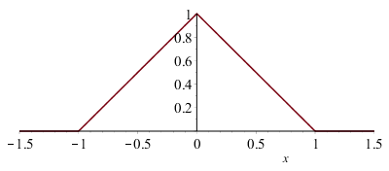
Checking conditional statements
Suppose you have a cascading conditional statement
It may be useful to ensure that the condition in the complementary alternative body is what is expected
#include <cassert>
// Function declarations
double tent( double x );
// Function definitions
double tent( double x ) {
if ( (x <= -1) || (x >= 1) ) {
return 0.0;
} else if ( x <= 0 ) {
return x + 1.0;
} else {
assert( (x > 0.0) && (x < 1.0) );
return 1.0 - x;
}
}

Slide 12
Summary
Following this lesson, you now:
Know how to use the assert “function”
Understand it can be used to:
The arguments passed to a function are as expected
Values are as expected when executing code
Understand that assertions are never needed in this course
They only help you catch errors in your own code

Slide 13
References
[1] Wikipedia: https://en.wikipedia.org/wiki/Assert.h
[2] Cplusplus.com
http://www.cplusplus.com/reference/cassert/

Slide 14
Acknowledgments
None so far.

Slide 15
Colophon
These slides were prepared using the Georgia typeface. Mathematical equations use Times New Roman, and source code is presented using Consolas.
The photographs of lilacs in bloom appearing on the title slide and accenting the top of each other slide were taken at the Royal Botanical Gardens on May 27, 2018 by Douglas Wilhelm Harder. Please see
https://www.rbg.ca/
for more information.

Slide 16
Disclaimer
These slides are provided for the ece 150 Fundamentals of Programming course taught at the University of Waterloo. The material in it reflects the authors’ best judgment in light of the information available to them at the time of preparation. Any reliance on these course slides by any party for any other purpose are the responsibility of such parties. The authors accept no responsibility for damages, if any, suffered by any party as a result of decisions made or actions based on these course slides for any other purpose than that for which it was intended.

